Slide 1
Diving into NYC Citi bike Usage
Group 5: Dylan, Boyuan, Mitthi, Abraham, Neeharika, Pengru

Slide 2
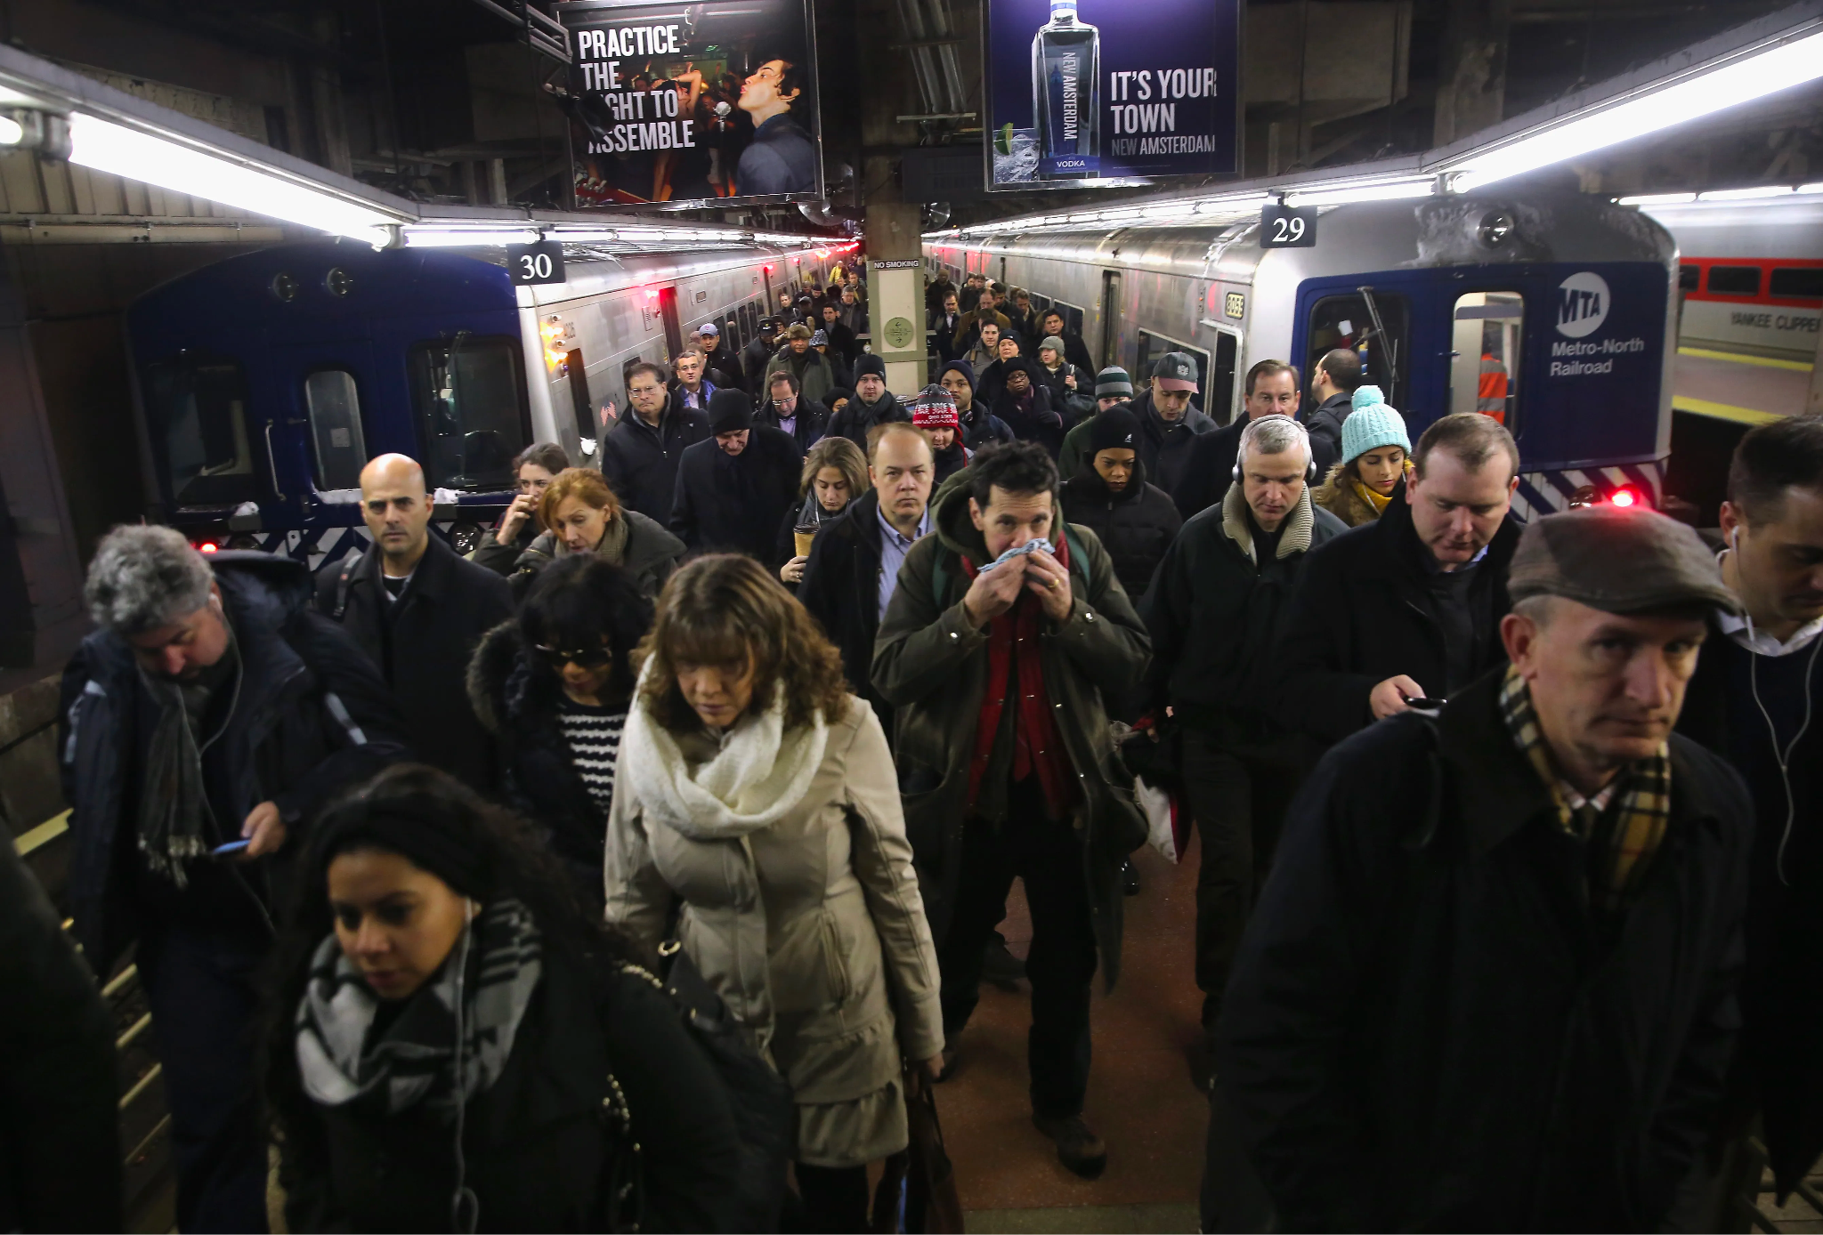
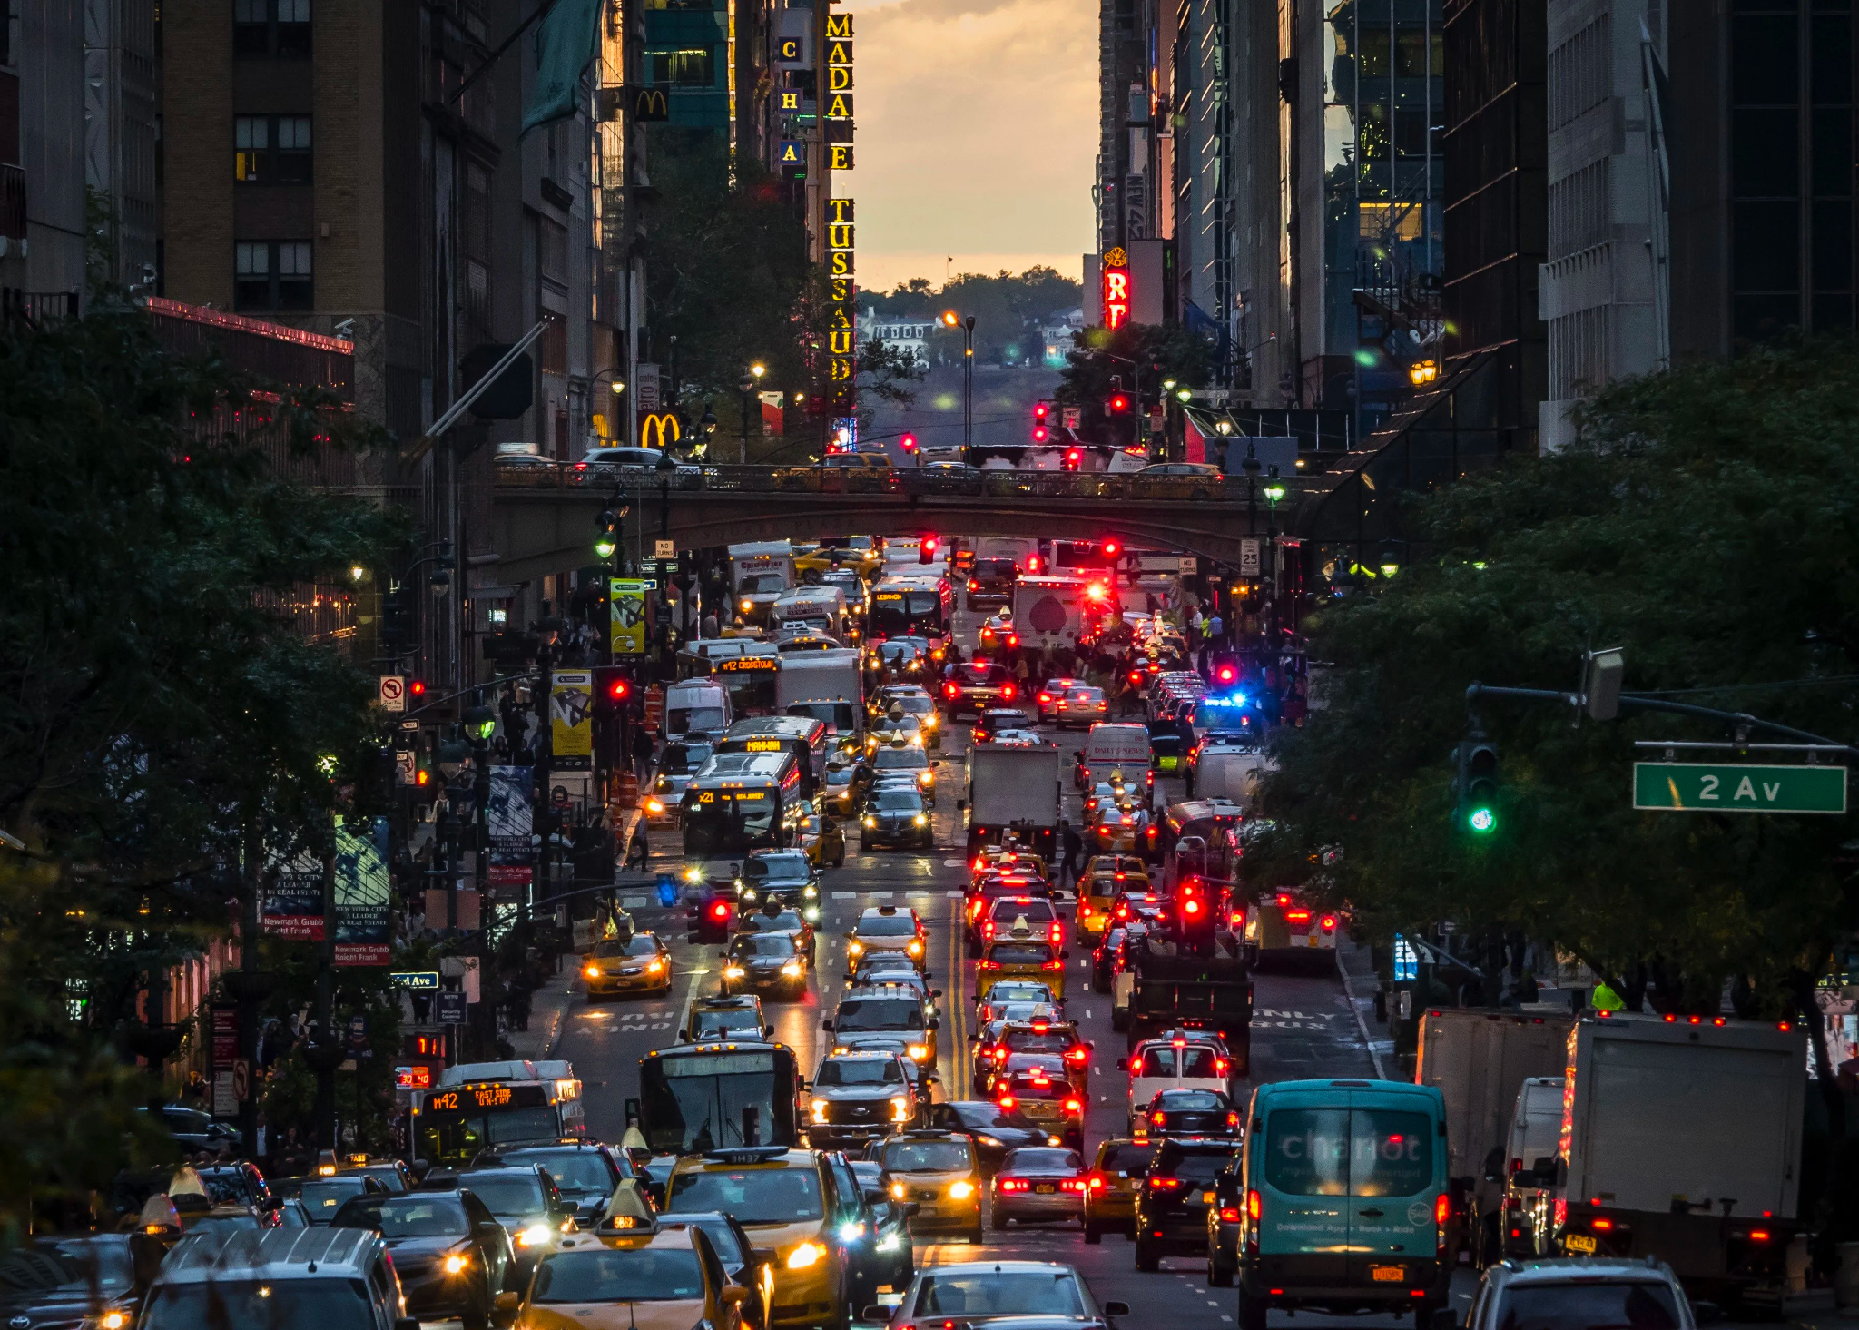
NYC 2014:
3.6 Million workers
55.6% public transportation
Process Loss:
149 minutes spent traveling
38 minutes (26%) waiting
Notes:
Every weekday morning, millions of workers step out of their doors with the hopes to reach the workplace on-time. Some drive cars, some people walk, while others have to rely on different means of public transportation. In New York City in 2014, there were roughly 3.6 million workers, and 55.6% of them rely on public transportation to get to work. According to the GlobeNewswire Article: “NYC respondents spent an average of 149 minutes on public transport each day, 38 minutes (26 percent) idly waiting for the bus or train to arrive, with a 40 percent dissatisfaction rate”. This time spent is considered to be 'process loss', which would cause the workers to be late to work, getting less leisure time, and eventually prevent the workers from reaching their full potential.

Slide 3
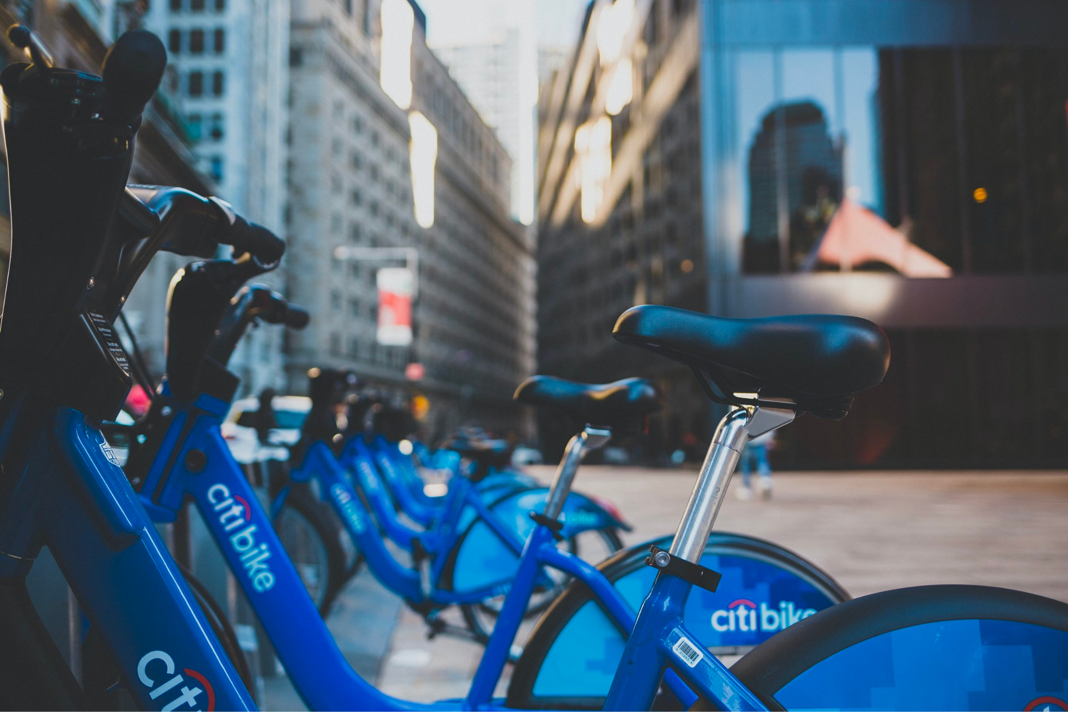
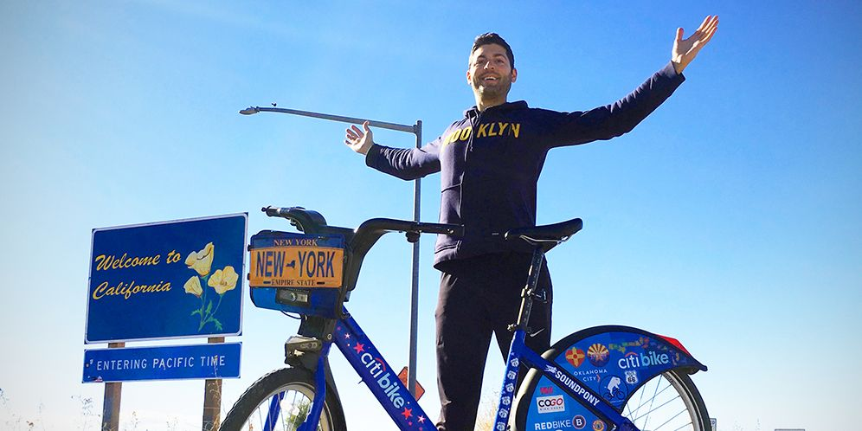
Car
Public transportation
Traffic
Late to work
Citi bike:
Affordable
Convenient
Easy to use
Notes:
This is where the Citibike comes in, an alternative solution for NYC residents who don’t have cars, don’t want to use taxis due to high fares and traffic, or those who live further from subway stops or don’t find the subway the most efficient for their route. Citibike is an affordable, convenient, and easy to use solution for NYC residents. We are motivated to provide Citibike with an analysis of user behavior to improve the quality of service in NYC, and also expand into other boroughs and increase accessibility to the bikes for more residents. With NYC as a successful prototype, Citibike will then be able to expand into other untapped markets across the country, improving quality of life for many residents and also helping everyone reduce their carbon footprint.

Slide 4

Our dataset
Column | Description
1. tripduration | How long the bike trip was in seconds
2. starttime | What time was the trip started and on what date
3. stoptime | What time the trip ended and on what date
6. start station latitude | Latitude coordinates of start station
7. start station longitude | Longitude coordinates of start station
13. usertype | Customer = 24-hour pass or 3-day pass user; Subscriber = Annual Member
14. birth year | Birth year of the rider
15. gender | 0=unknown; 1=male; 2=female
16. weekend | 0=weekday; 1=weekend
17. holiday | 0=workday; 1=holiday

Slide 5
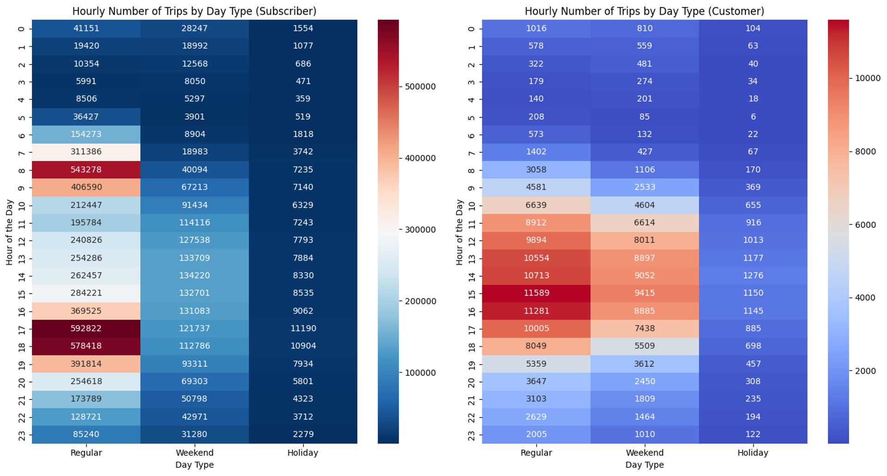
Usage Pattern of Subscribers & Customers
On Regular Days:
Subscribers use shared bike service during typical work/school commute hours;
Customer usage: leisure & impromptu usage
On Weekends/Holidays:
Mid-day usage (recreational ride)
From Business Side:
Focus more on subscribers’ riding experience

Slide 6
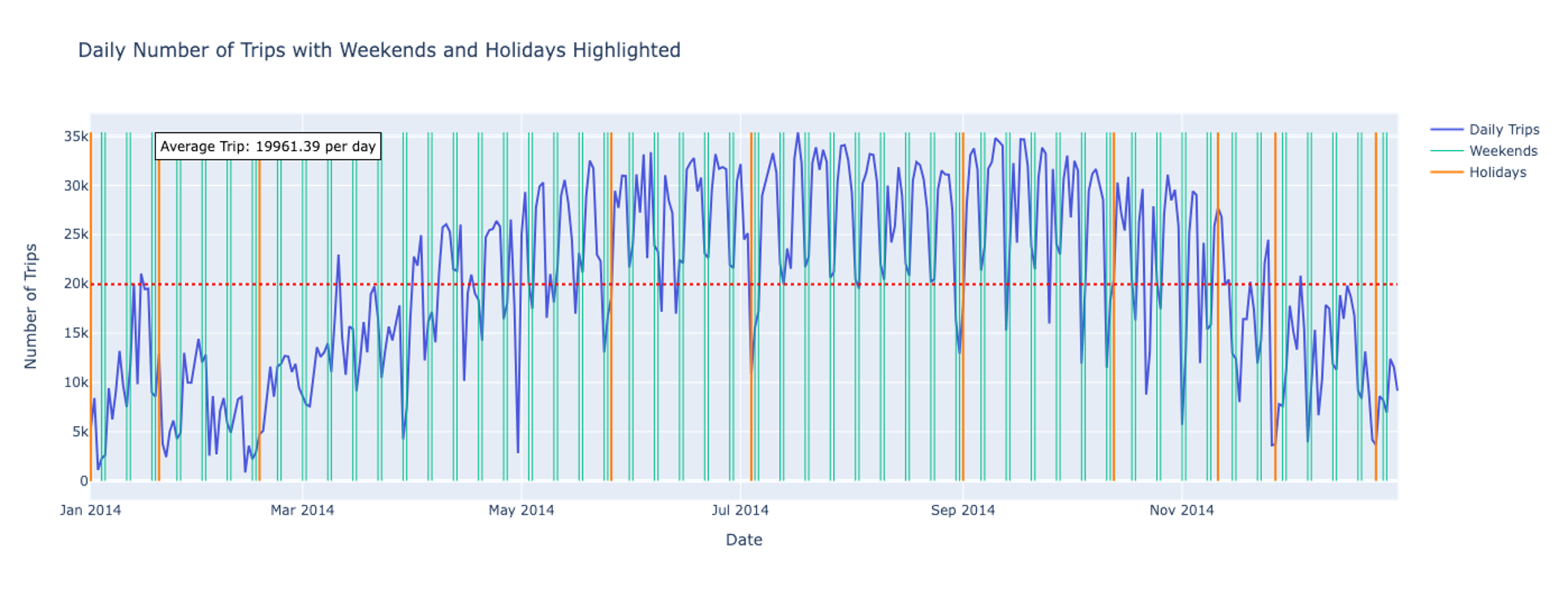
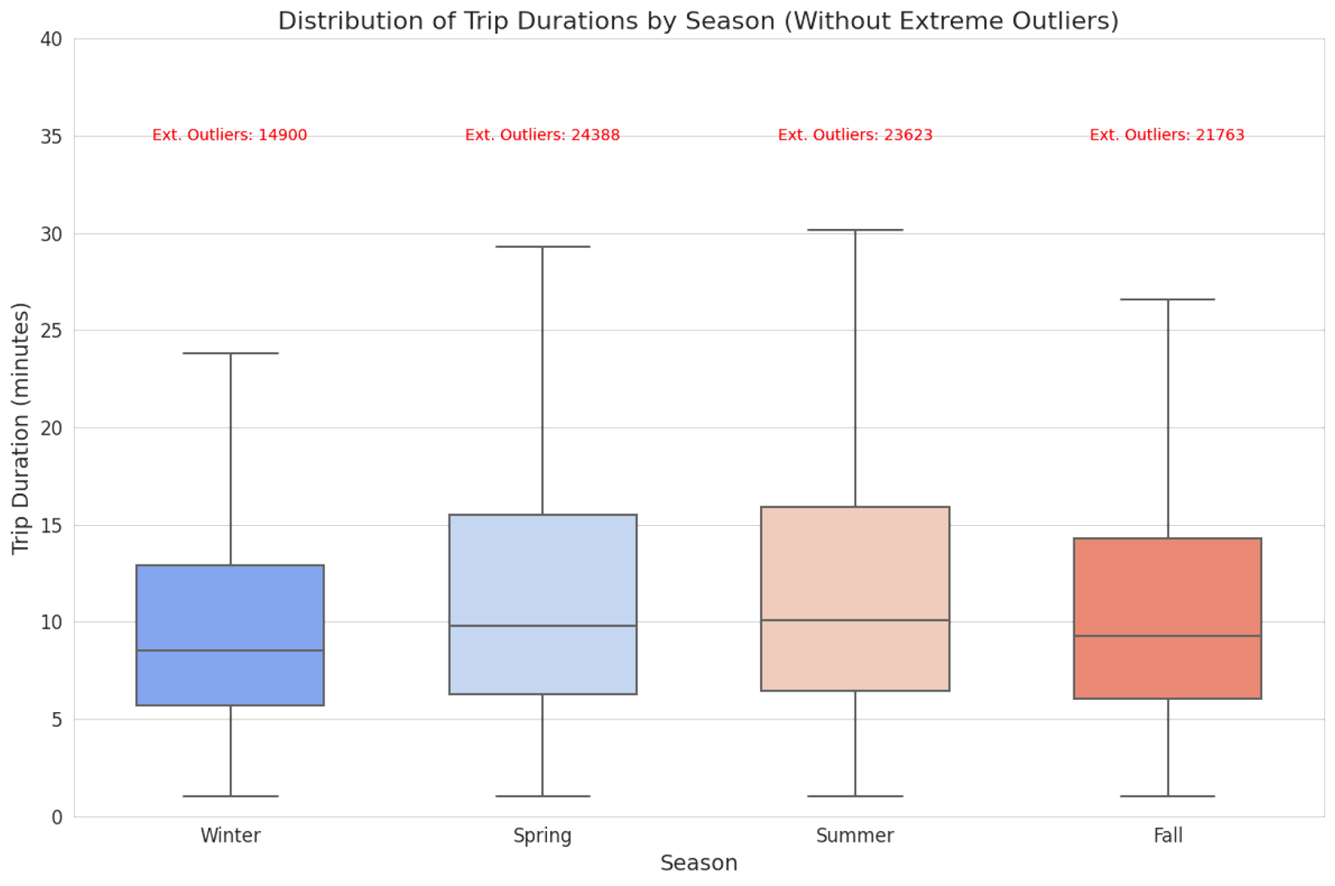
In the summer and fall, the amount and duration of shared bike use increases.
For most weekends, there’s a decrease in the usage frequency of shared bikes
For holidays, the number of trips are always below average (19961 per day)

Slide 7
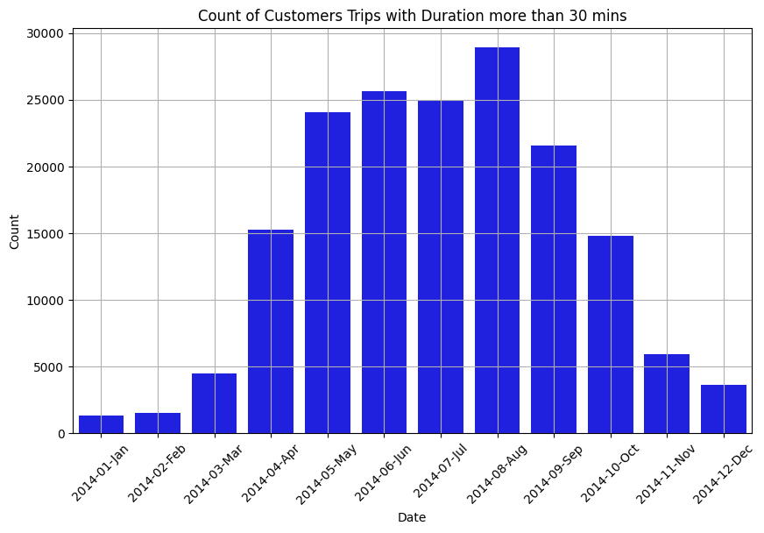
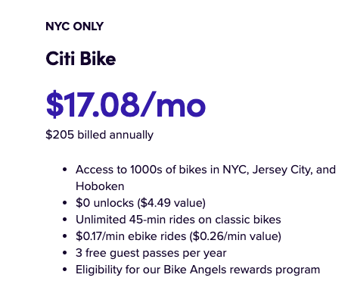
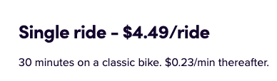
Why have customers not become a subscriber yet?

Slide 8
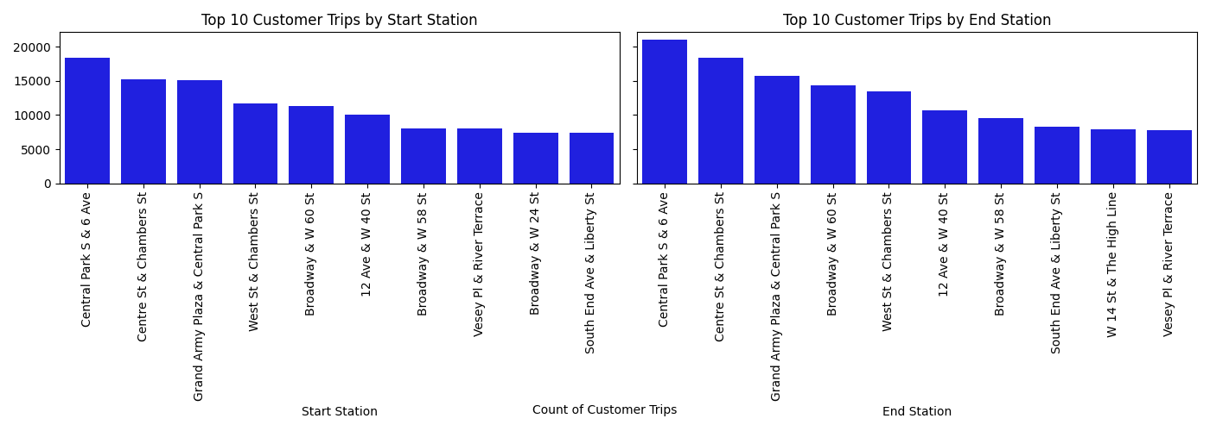
What are the Top 10 start and end stations for customers?
Most of the top 10 start and end stations are located around famous NYC attractions, such as Central Park, Brooklyn Bridge.
The Citibike should consider to give promotions at the popular tourists attractions to encourage customers becoming subscribers.

Slide 9
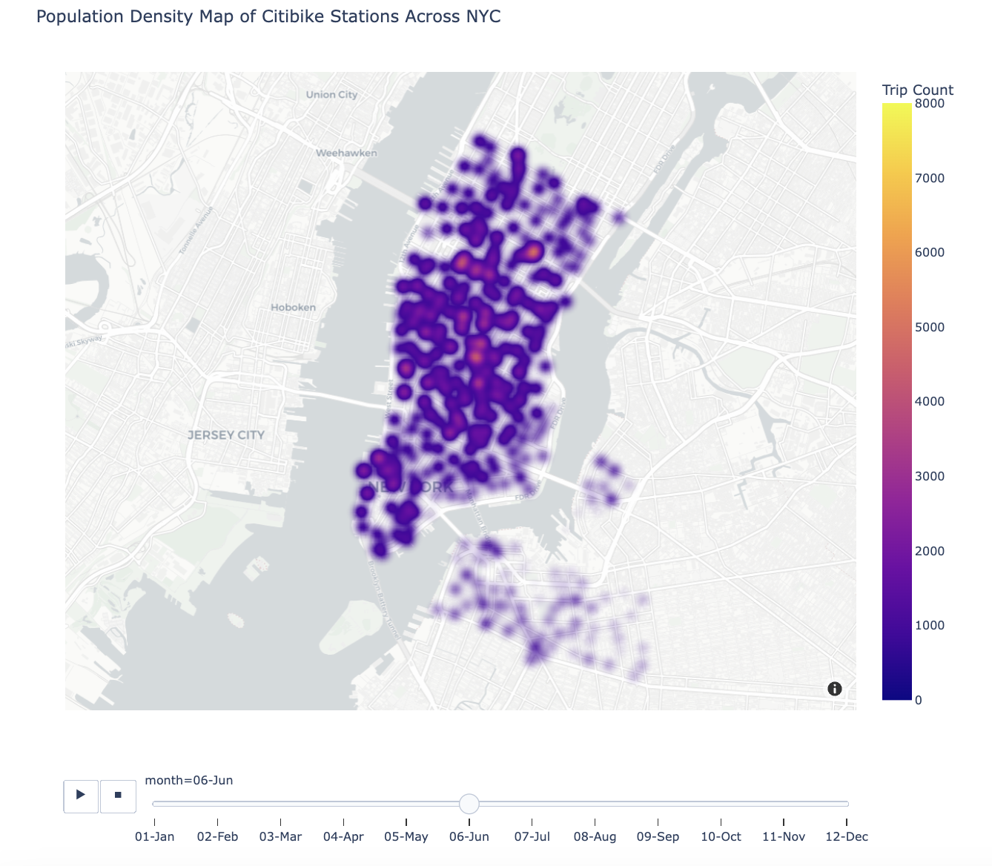

Most popular start stations
Recommendation: Expand into other areas!
April - October are the most popular months

Slide 10
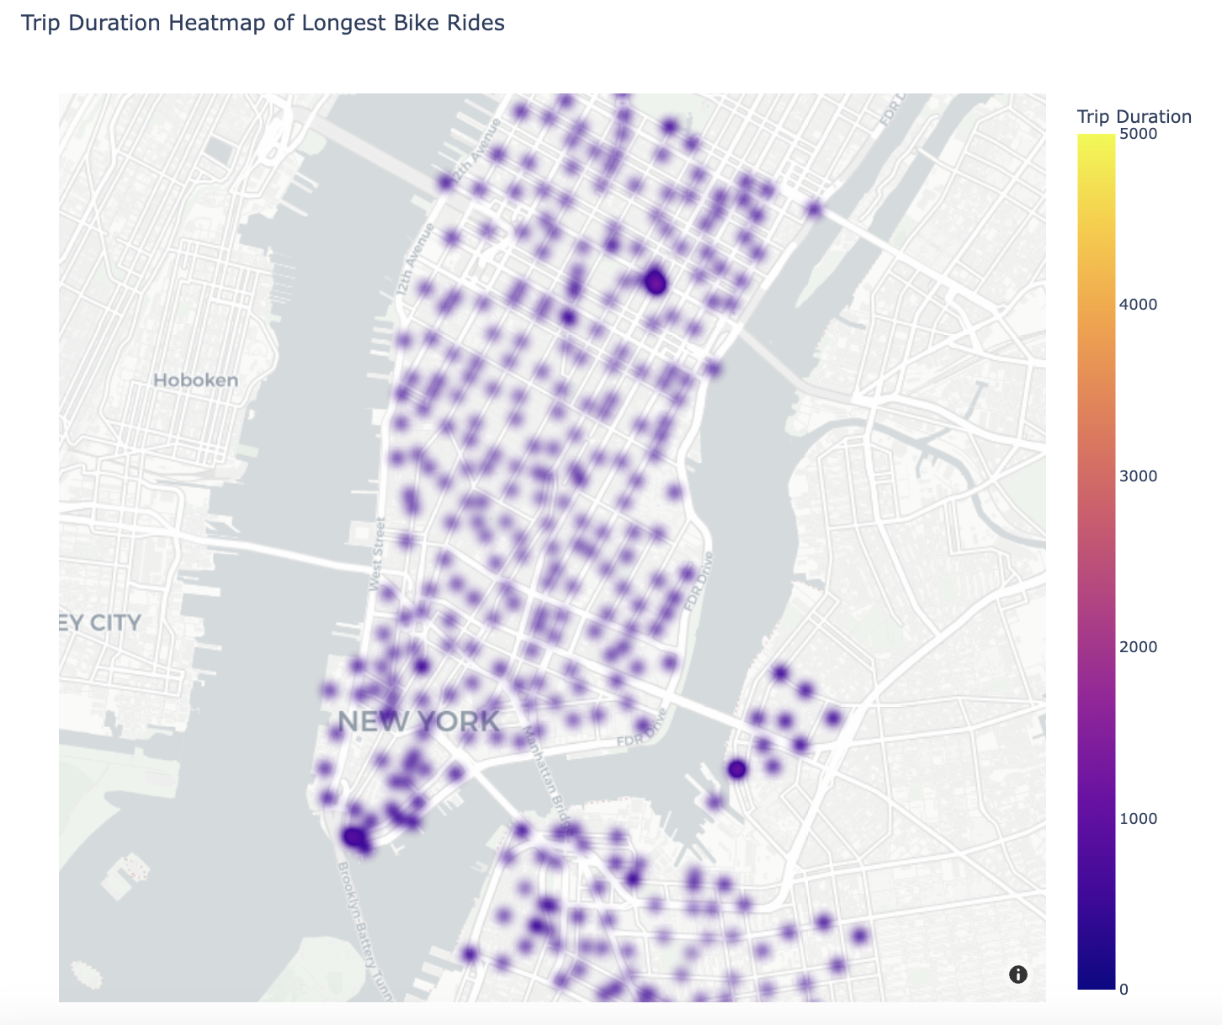
Where are the longest rides?
Midtown -> Long Island City (via Queens Midtown Tunnel) Also near Grand Central!
Recommendation:
Special attention + resources should be invested in consistently & quickly maintaining bikes near bridges.
General bikes need repairing every 25 hours of ride time.
Williamsburg -> LES (via Williamsburg Bridge)
FiDi/Downtown -> Brooklyn (via Brooklyn Bridge)

Slide 11
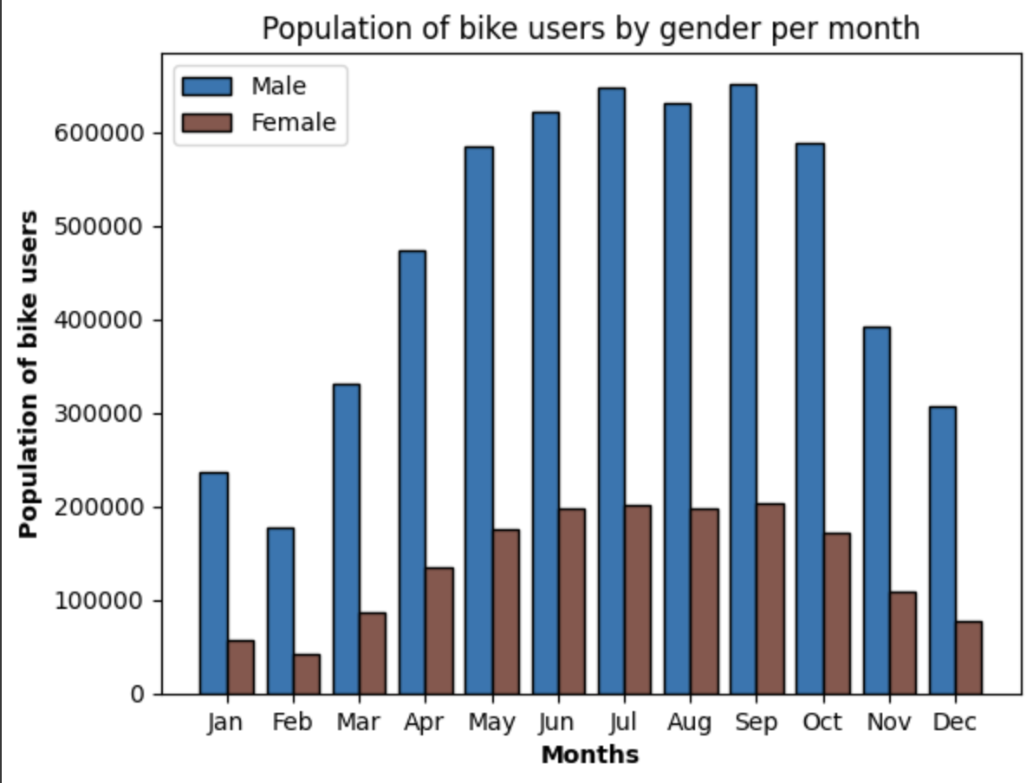
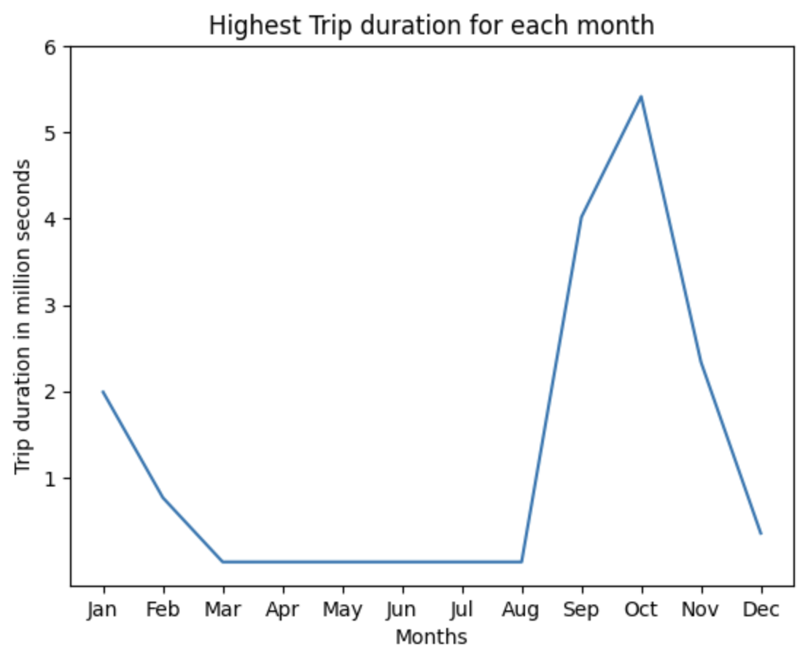
Number of Bike users vs. Trip Duration
Recommendations:
Between March and August, the company should increase bikes availability and make frequent bike service checks.
More strategies can be formulated towards women as they constituted 52% of NYC’s population in 2014.

Slide 12
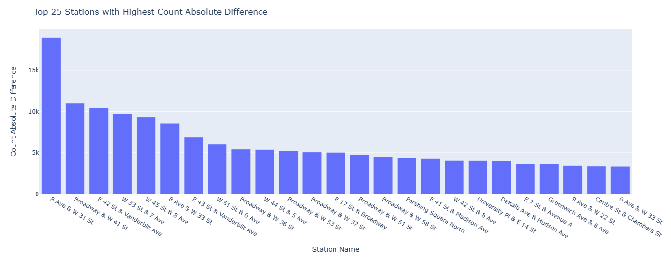
How to Keep Your Subscribers Happy: The Best Stations to Refill
Inadequate bikes in these stations can be costly for the company.
An excess of demand or an excess of supply being unfulfilled.

Slide 13
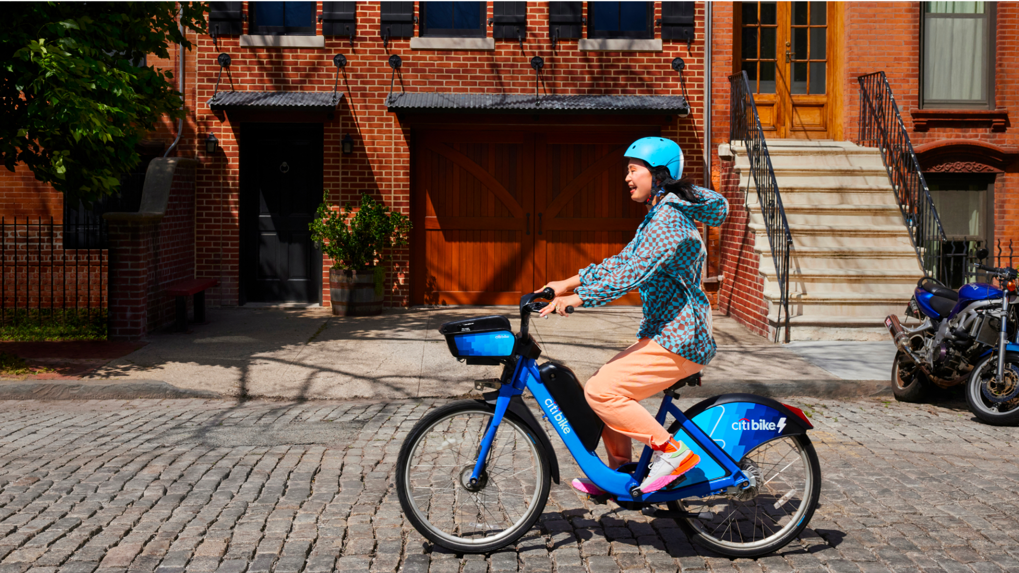
Thank You

